Slide 2
Made in the USA

Slide 3
Waterstone Team
Chris Kuran
President
Steve Kliewer
VP of Manufacturing
Paul Yandell
VP of Operations

Slide 4
The Family

Slide 5
Suites
3 Traditional and 3 Contemporary Faucet Suites

Slide 6
Faucet Suites
Suites Include Up to 10 Pieces
Add matching accessories – Side Spray, Air Switch, Air Gaps, Soap/Lotion Dispensers and Escutcheon Plates.

Slide 7
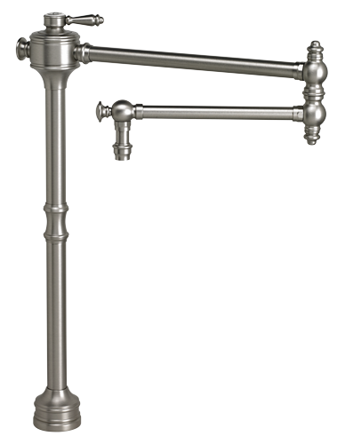
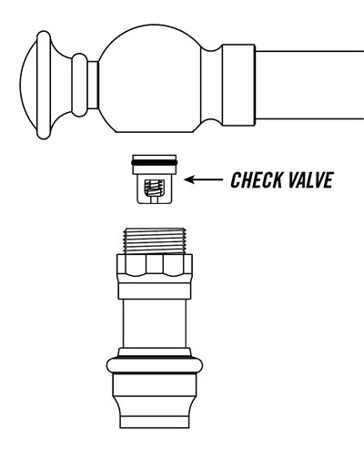
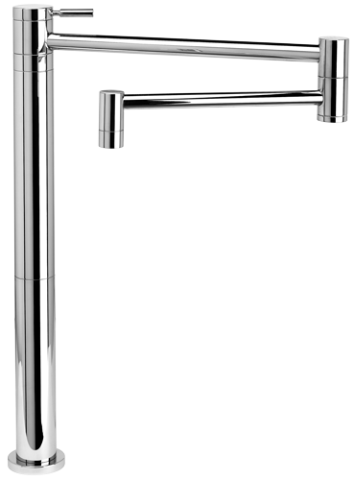
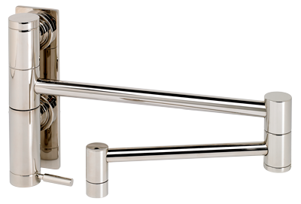
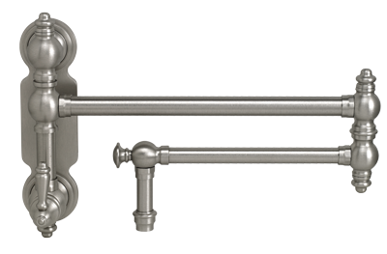
Potfillers
Wall and Counter Mounted

Slide 8
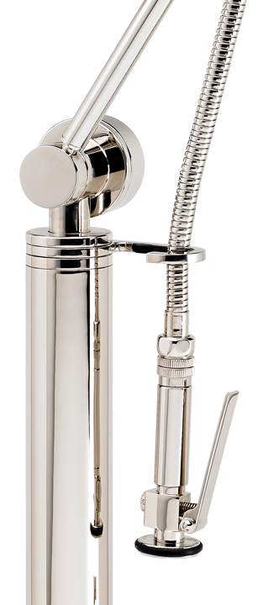
Warranty
Lifetime Functional Warranty
The Last Faucet You’ll Ever Buy

Slide 9
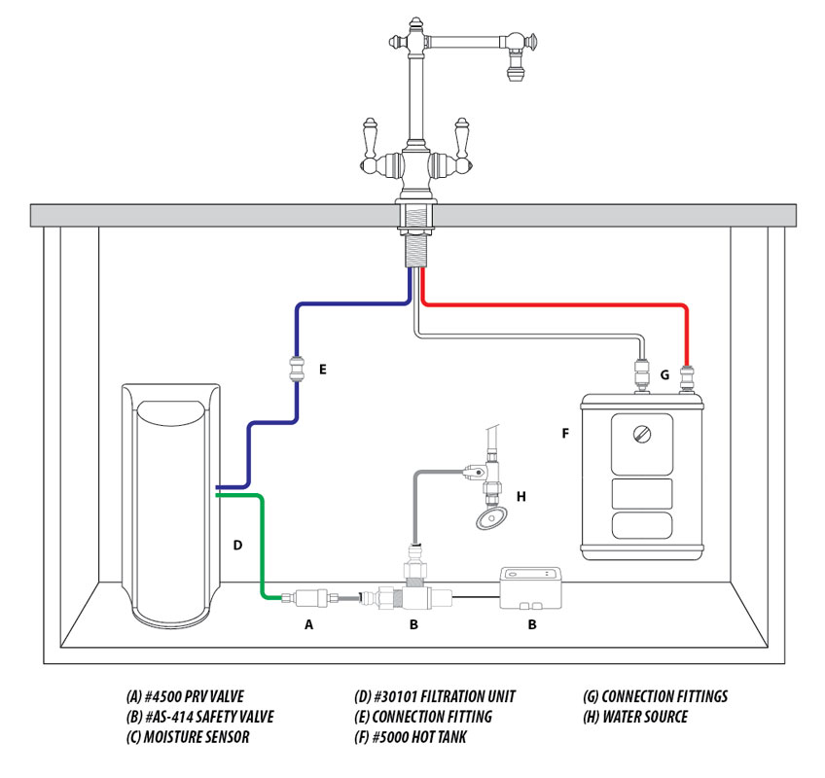
Hot Tank
Instant Hot Water
Includes Pressure Regulator Valve

Slide 10
Safety Valve Leak Detector
Stop the Flood!
Minimizes water damage.
Auto shut off when water is detected.
Colored LED indicators and audio alarm.
Use with Waterstone Hot Tank and/or Filtration unit.

Slide 11
Hardware
Cabinet Knobs
Cabinet Pulls
Appliance Pulls

Slide 12
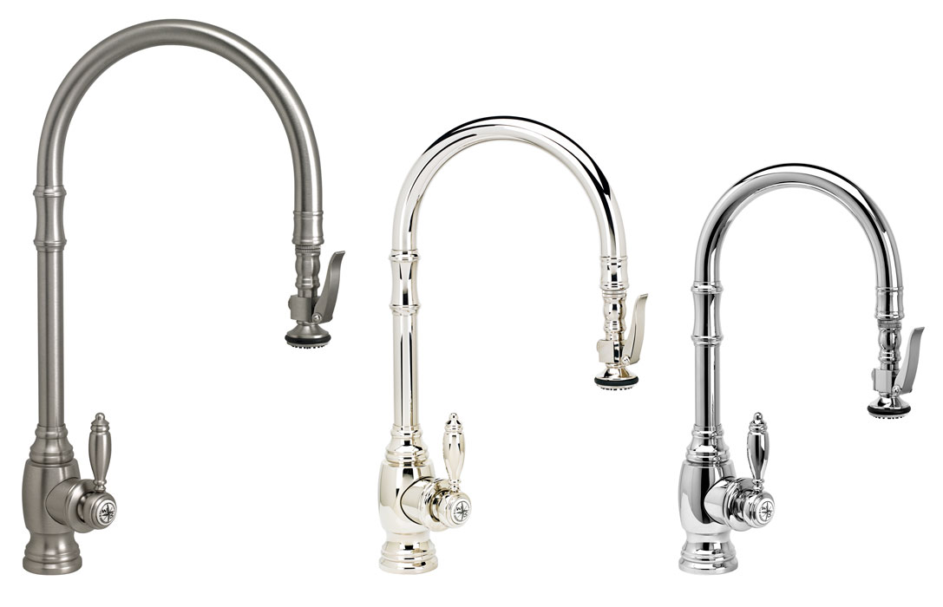
Traditional PLP Pulldown Faucets
Extended Reach, Standard Reach & Prep Size

Slide 13
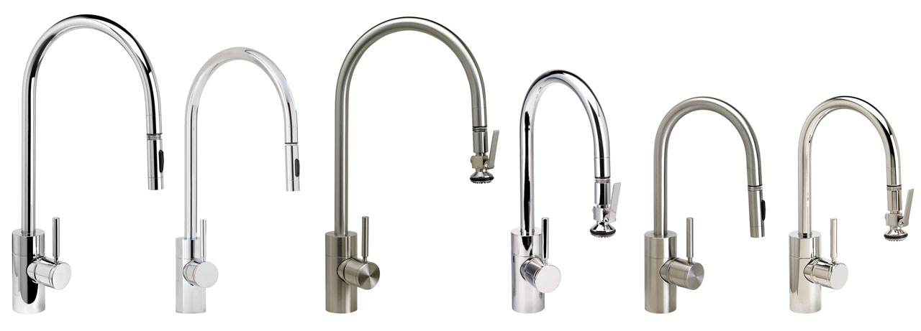
Contemporary PLP Pulldown Faucets
Extended Reach, Standard Reach & Prep Sizes

Slide 14
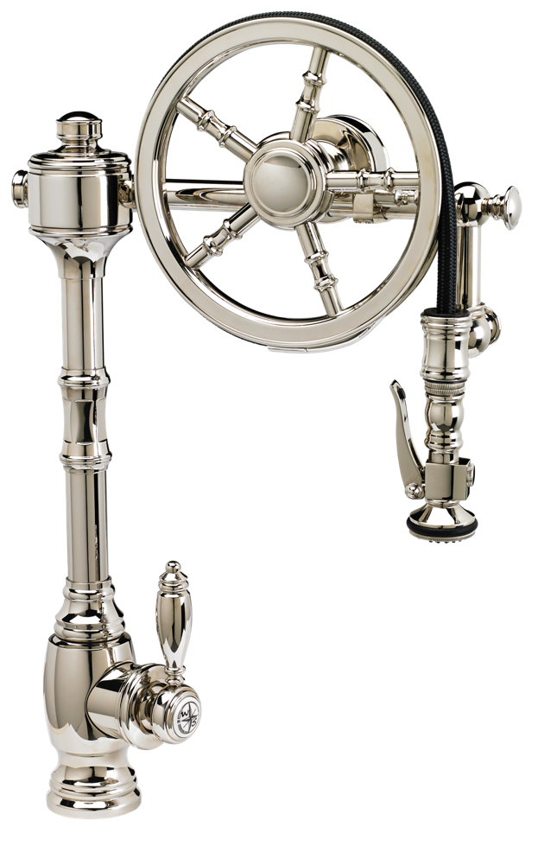
The Wheel Pulldown Faucet
You CAN re-invent the wheel!

Slide 15
Finishes
30 Finishes + Solid Stainless Steel
New for 2018!
Classic Bronze

Slide 16
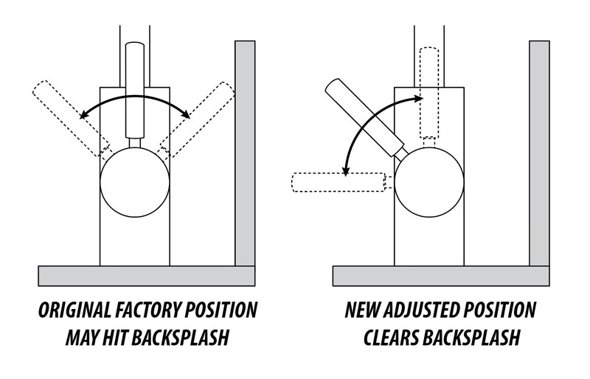
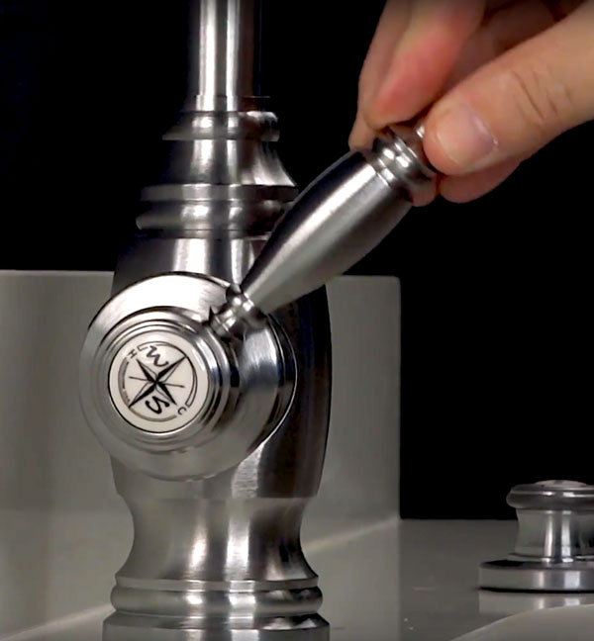
Handle Options
Adjust Faucet Handle to Clear Backsplash

Slide 17
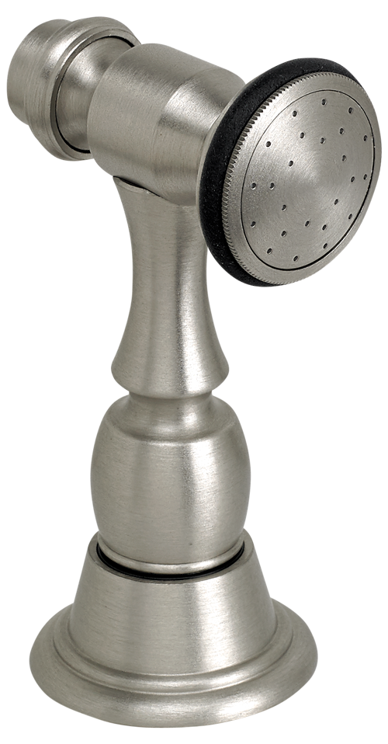
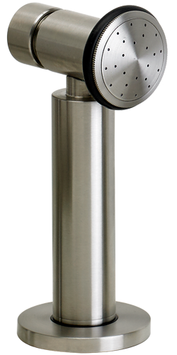
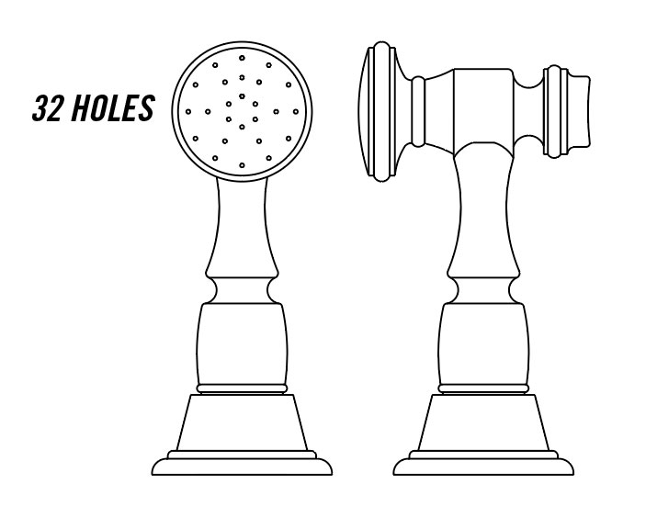
Side Sprays
Traditional and Contemporary Styles

Slide 18
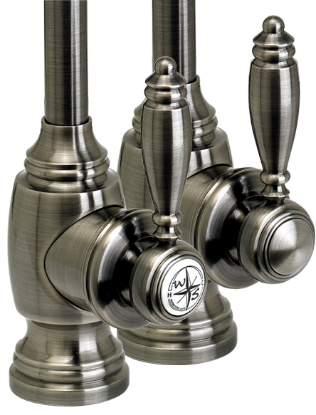
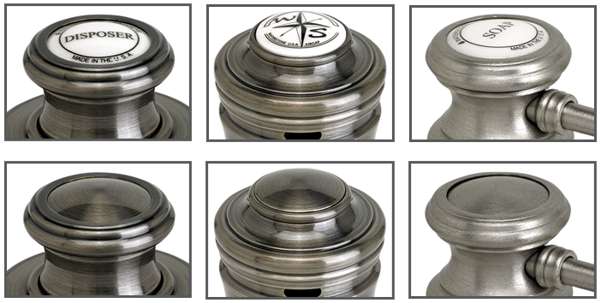
Decorative Buttons
Choice of decorative buttons included with traditional faucets and accessories.

Slide 19
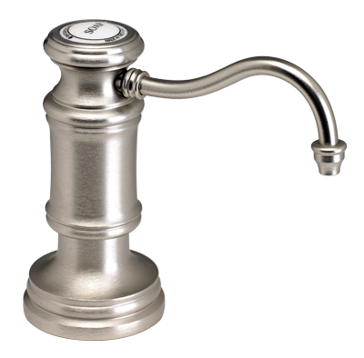
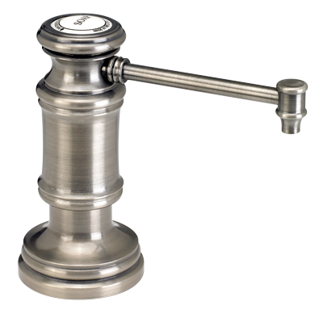
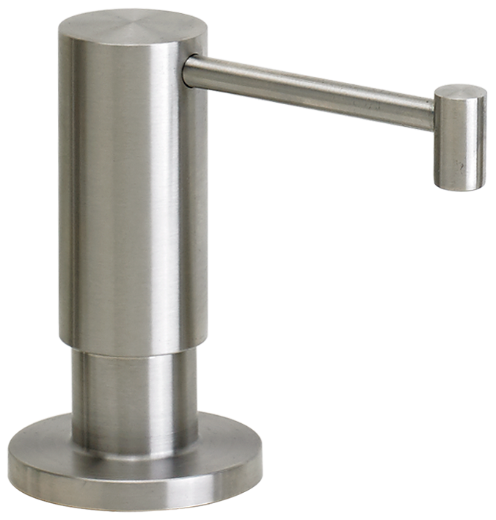
Soap/Lotion Dispensers
2 Traditional and 1 Contemporary Styles
Made with Anti-Wick Spouts

Slide 20
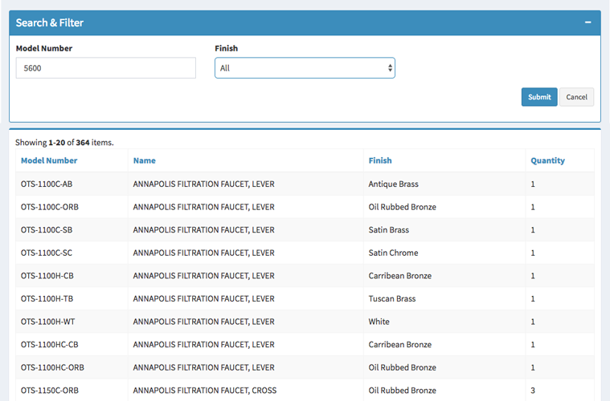
Waterstone Stock Inventory
Ships in 1 Business Day
Search waterstoneco.com to see daily inventory.

Slide 21
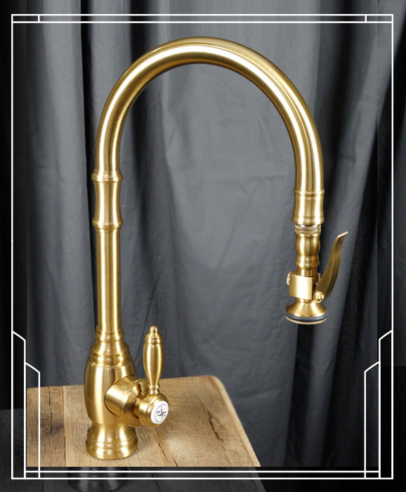
New Finish
2018 - Introducing the 30th Finish to Our Product Line.

Slide 22
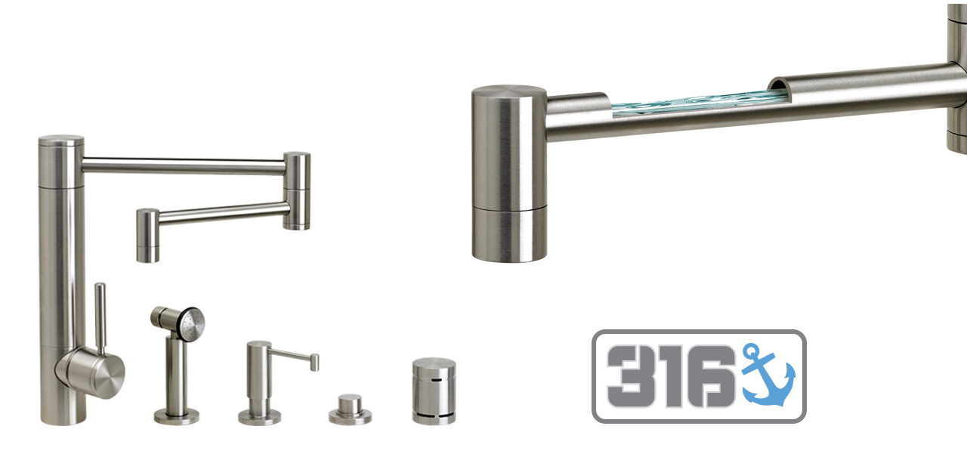
New Stainless Steel
316 Marine Grade Stainless Steel
Maximum resistance to corrosion, pitting and staining from sitting water or soap.

Slide 23
Thank You!
www.waterstoneco.com

